Slide 1
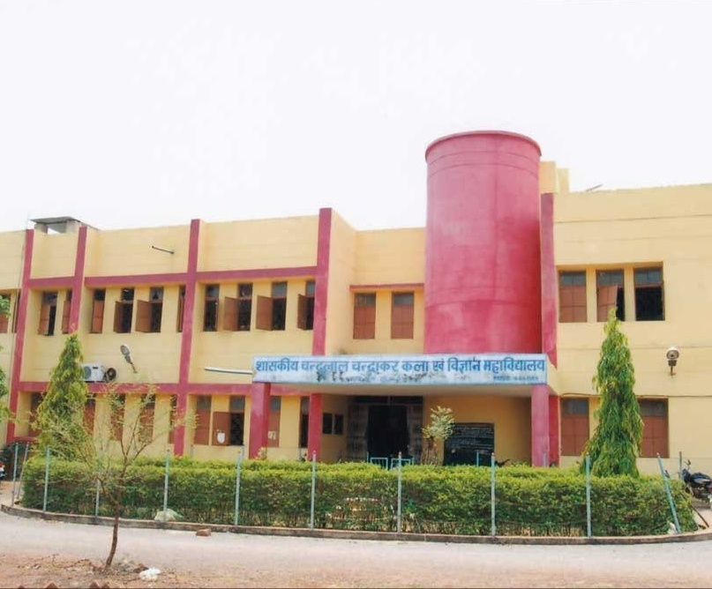
Department of Commerce Government Chandulal Chandrakar Arts and Science College Patan, Durg, Chhattisgarh
Welcomes NAAC Peer Review Team
Visit on 15th & 16th September 2021

Slide 2
Content of Department
Department at Glance.
Mission , Vision, and core Values.
Courses Offered by Department.
Profile of Teaching Faculties.
Department Set up.
Best Practices of Department.
Specialised Visited Faculties Invited and Academic programme conducted by department.
Name of Institutions by which Departmental Faculties Invited as Special Guest for academic and professional programmes.
Research and Academic Area.
Participations of Students of Department in Cross-Functional Activities
Student Enrolled during 2014-15 to 2020-21
Result Analysis from 2015-16 to 2019-20
Role of Departmental Faculties in College, Organizational Committees and Bodies
Teaching Methodology and Performance Appraisal System.
Department Outcomes.
Future course of Action for Department.

Slide 3
Department at Glance
Particulars | Details
Name of Department | Department of Commerce Government Chandulal Chandrakar PG College Patan, Durg, Chhattisgarh
Courses Offered by Department | B.COM, M.COM
Year of Establishment | UG – 2012 PG - 2020
Number of Faculties Setup Number of faculties posted Number of Post Vacant ( Fill- up by GL) | 02 01 01
Intake | B.COM. 60 M.COM 20
Number of rooms with IT facilities | 01
Numbers of Books in Departmental Library | 74 Including Professional and NET ,SET Books

Slide 4
VISION AND MISSION OF DEPARTMENT
VISSION
“The Department of Commerce Seeks to Provide Students with Learning Capabilities and Approaches to Face Global Challenges in National and International Market to Meet Requirement of Sustainable Development of National and International Community.”
MISSION
“To Transform Education to Students in Manner to Achieve Complexity of Job Market with the Integration of Technologies in Field of Financial, E- Commerce, Human Resources to Provide Value Based Products and Services to Society.”

Slide 5
Core Values
To provide efficient knowledge channel for transformation of core ideas in subject.
To provide an updated knowledge resources for complicated commercial , economical and legal requirement regarding field of business and profession.
To provide valuable, subjective , market oriented ideas and its linkage with society.
To transforms financial reporting framework and stranded for understanding requirement of financial statement presentation and disclosure .
To provide knowledge for updated ,subject oriented, technical complexity related matters in subjective manner.

Slide 6
Courses Offered by Department
Name of Course Offered | Course Operated and Steam of Courses | Credit System
UG | B.COM. Accounting Management Economics Taxation Auditing Corporate and Economic Law | Annual
PG | M.COM. Specialised Accounting Financial Management Economic and Corporate Law Tax Planning and Management Financial Management | Semester

Slide 7
The Best Practices of Department
Distribution of Sample Books to Students.
Free Access of Departmental Professional Books to Students.
Facilitation to College Staff Members for Compliance of Direct Tax Related Matters.
Organization of Various Workshop and Seminar in Recent Industry Oriented Matters.
Career Counselling by Eminent Professionals.
Group Presentation by Students in ICT Oriented Class Facilities.

Slide 8
The Profiles of Teaching Faculties
Name of Faculties | Designation | Qualifications | Area of Specialization | Teaching and industrial Experience
DR. GAURAV SHARMA | Assistant Professor | M.COM. MA Economics Cost and Management Accountant CMA Company Secretary CS NET (JRF) SET Ph.D. | Taxation Financial management Accounting Corporate Law Auditing | 05 08 years of experiences as auditor in Chhattisgarh government
DAVESH KUMAR GAJPAL | Guest lecturer | M.COM. NET B.ED. D.CA. | Costing Statistics Business Law | 01

Slide 9
Post Sectioned and Posted Faculties Details
particulars | No. of post sanctioned | No. of posted faculties
Professor | Nil | Nil
Associate professor | Nil | Nil
Assistant professor | 02 | 01
Guest Lecturer JBS Lecturer | Nil | 01 GL Against Assistant Professor

Slide 10
List of Professional Faculties Invited in Academic Programmes Conducted by the Department
National seminar on Contemporary Issues in India Banking Sector on 21.11.2019
Chief Guest of Seminar- Dr. M.K Verma
Vice Chancellor of Swami Vivekananda University Bhilai
Other Eminent Resource Persons
Date of seminar | Technical session | Name of guest person | No. of participants | No. of articles
21/11/2019 | First | DR. R.N SINGH Principal VYT PG College Durg | 156 | 28
21/11/2019 | second | DR. S.K. AGWAWAL Assistant professor Durga College Raipur | 125 | 33

Slide 11
Continued 02: Other Academics Programmes
Workshop on Goods and Services Tax by Marg Telecommunication Ltd. As on 14/12/2018.
Workshop on Career Guidance by The Institute of Companies Secretary of India as on 15/01/2019.
Workshop on Merger of Public Sector Banking in India An on 15/01/2019.

Slide 12
Name of Institutions by which Departmental Faculties Invited as Special Guest for Academic and Professional Programmes
Names of Institutions | Dates of Lecture Delivered | Topics of Lectures | No. of Participants
Govt. College Machandur Durg | 10/01/2020 | Financial Accounting | 92
Govt. College Dharsiva Raipur | 04/01/2021 | An Introduction of GST | 96
Sai College Bhilai | 05/05/2021 | Investment and Tax Planning | 82
Govt. College | 24/07/20211 | Return Filling and Assessment Proceeding | 53

Slide 13
Research and Academic Areas
S.N | Name of Faculties | No . Of Research papers in referred journals | No . Of Seminar & Workshop attended | No. of orientation programme attended | Other faculty oriented programme
01 | Dr. GAURAV SHARMA | 12 | 15 | 01 | 01

Slide 14
Participations of Students of Department in Cross-functional Activities
NSS
Sports
Cultural Activities
Red Cross
English Language Labs

Slide 15
Students Enrolments for B.Com from
2014-15 to 2020-21
Year | B.COM. I |  |  | B.COM. II |  |  | B.COM. III
 | Male | Female | Total | Male | Female | Total | Male | Female | Total
2014-15 | 34 | 26 | 60 | 7 | 2 | 9 | 3 | 1 | 4
2015-16 | 27 | 26 | 53 | 11 | 9 | 20 | 6 | 3 | 9
2016-17 | 24 | 22 | 46 | 16 | 28 | 44 | 8 | 12 | 20
2017-18 | 23 | 25 | 48 | 13 | 20 | 33 | 11 | 23 | 34
2018-19 | 34 | 36 | 60 | 15 | 16 | 31 | 4 | 11 | 15
2019-20 | 28 | 32 | 60 | 13 | 33 | 46 | 9 | 22 | 31
2020-21 | 20 | 40 | 60 | 26 | 32 | 58 | 16 | 33 | 49

Slide 16
Figure of Students Enrolled Data

Slide 17
Data of Students Enrolment for M.COM. From 2020-2021
YEAR | MALE | FEMALE | TOTAL
First Semester | 08 | 11 | 19
Second Semester | 08 | 11 | 9

Slide 18
RESULT FROM 2015-16 TO 2019-20
Year | B.COM. I |  | B.COM. II |  | B.COM. III
 | Students Appeared and Passed |  | Student Appeared and Passed |  | Student Appeared and Passed
2014-15 | 56 | 18 | 09 | 06 | 04 | 03
2015-16 | 53 | 35 | 19 | 16 | 10 | 00
2016-17 | 42 | 15 | 42 | 20 | 20 | 18
2017-18 | 45 | 23 | 29 | 15 | 34 | 13
2018-19 | 57 | 57 | 18 | 18 | 15 | 14
2019-20 | 56 | 56 | 45 | 45 | 34 | 29

Slide 19
RESULT FROM 2015-16 TO 2019-20

Slide 20
Roles of the Faculty in Various Committees
Name of Committee | Position Held in Committee | Specification of Duties Performed by the Faculty
RUSSA Right to Information Act 2005 | Member Co-coordinator | In Area of Financial Inclusion and Ordered by the Superior Authority Matter Related to Right to Information Act 2005
Financial Policies, Financial Reporting Applicability Written off and Direct Tax Related Committees | Inspection and Verification of Books of Accounts | Cash Book Management and Compliance Matter in Accounting and Income Tax Related Matters

Slide 21
Continued 02: Roles of the Faculty in Various Committees
Name of Professional Body | Position Held | Membership Number | Remark
THE INSTITUTE OF COST ACCONTS OF INDIA | Associate Member | 39686 | Body Constituted by an act of Parliament
INDIAN ACCOUNTING ASSOSIATION | Member | M-13 | Professional Registered Body of Accountants and Professors

Slide 22
T Teaching Methodologies and Performance Appraisal System
Classroom Teaching
Cloud Computing Based Searching
Group Discussion
Teaching through Seminars and Workshops
Presentation in ICT Mode by students
Social Media App Based Teaching
Industry Oriented Teaching
Case Study Based Practical Teaching

Slide 23
Departments Outcomes
There are increase in trends of students enrolled and admitted in last five academic years.
There are increasing in trend of result pattern since academic year 2016.
Focused in practical based teaching approaches.
Introduction of PG programme in commerce in session 2020.
Accomplishment of seminars and various subject specific programs in the departments like GST, Merger of public sector banking etc.
Platform and knowledge sharing with very eminent professional bodies like THE INSTITUTE OF COMPANIES SECRETORY OF INDIA professionally eminent and academic persons.

Slide 24
SPECIAL FEATURE OF COMMERCE FACULTIES
Excellence faculties with securing university merit rank holder twice by Gaurav sharma in M.COM., and M.A Economics securing 2nd rank at pt. RSSU Raipur and Devesh kumar in top merit rank in M.COM. At hemchand yadav university durg.
UGC NET (JRF) , C.G SET by Gaurav sharma and NET qualified by Devesh kumar.
Industrial experienced faculties prior to joining of department of higher education.
Eminent Professionally qualified and computer qualified faculties with ICAI, ICSI and computer programme.
Selected faculty of Devesh kumar in C.G PSC list of assistant professor in commerce subject.

Slide 25
Future Course of Action for Department.
Establishment of Research Centre Affiliated with the university.
Introduction of Coursers Related to Financial Reporting Framework and Standard of Accounting.
Facilitation of Competitive and Academic Exam Frame work with Establishing More Human Resources in Department.
Establishment of MOU Agreement with Eminent Professional Institutions.
Facilitation of Software Based Accounting courses.

Slide 26
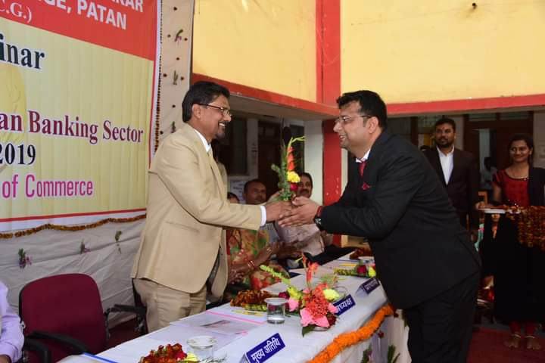
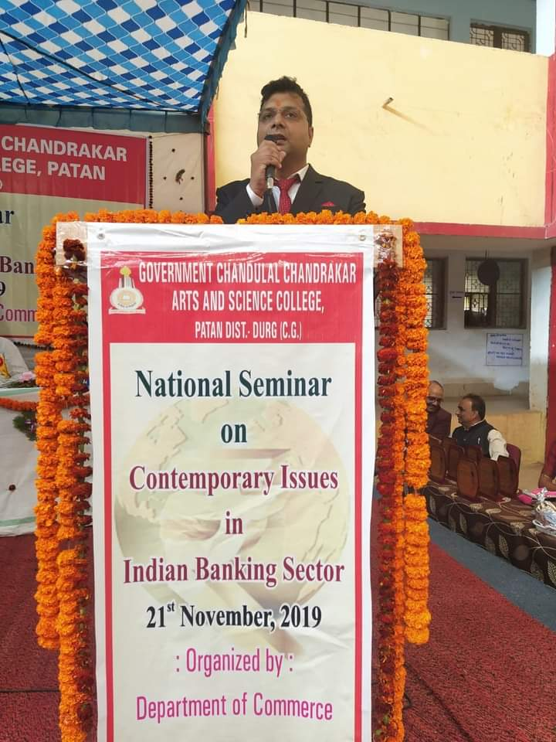
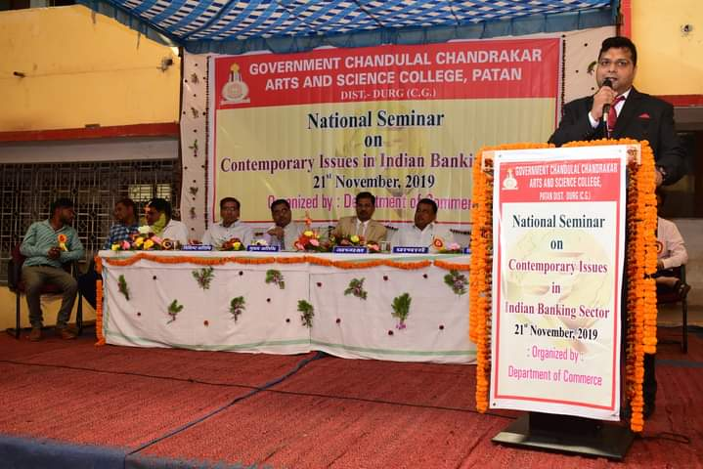
DEPARTMENT PHOTO GALLARY National Seminar in Contemporary Issues of Indian Banking System as on 21/11/2019

Slide 27
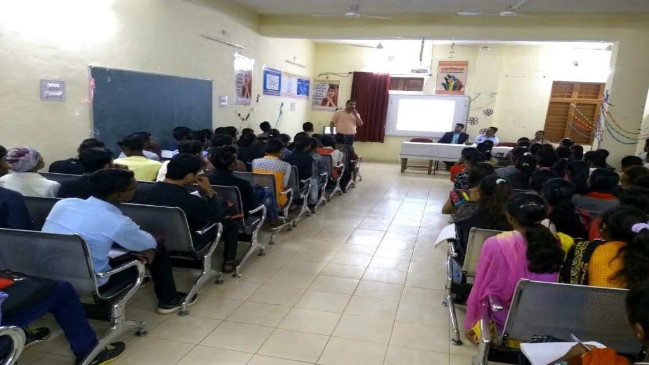
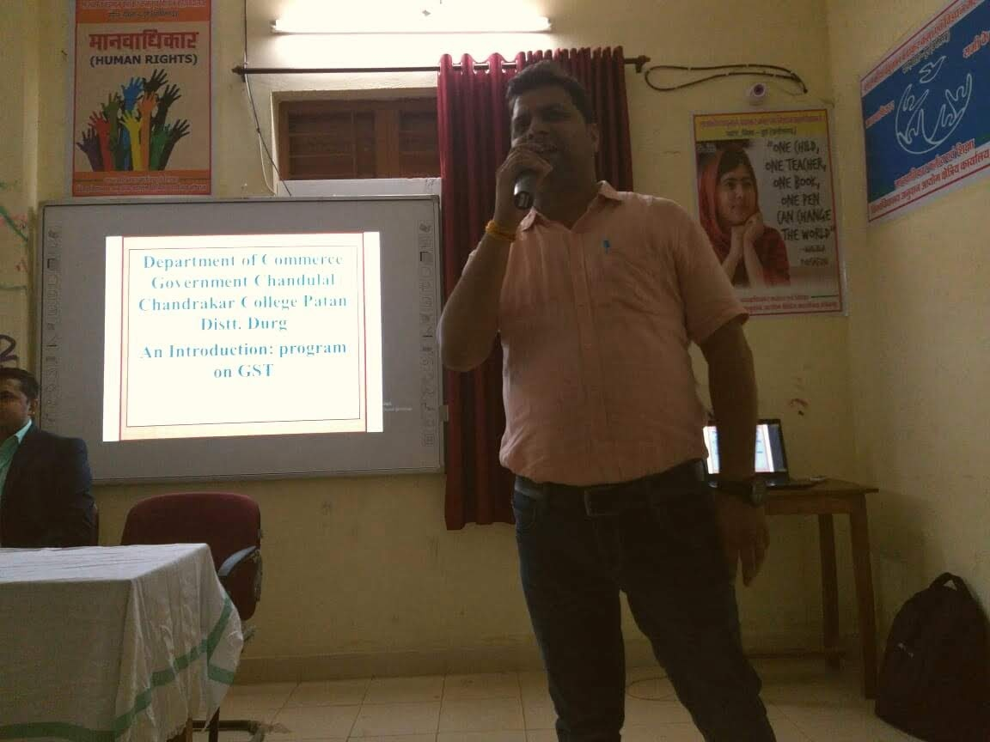
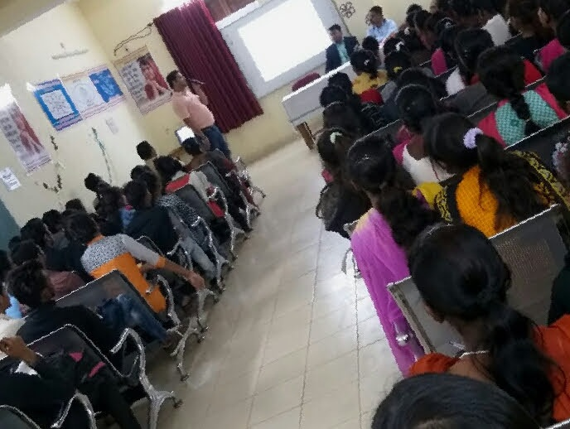
Workshop on GST and Banking as on 15-12-2018 and 15-01-19

Slide 28
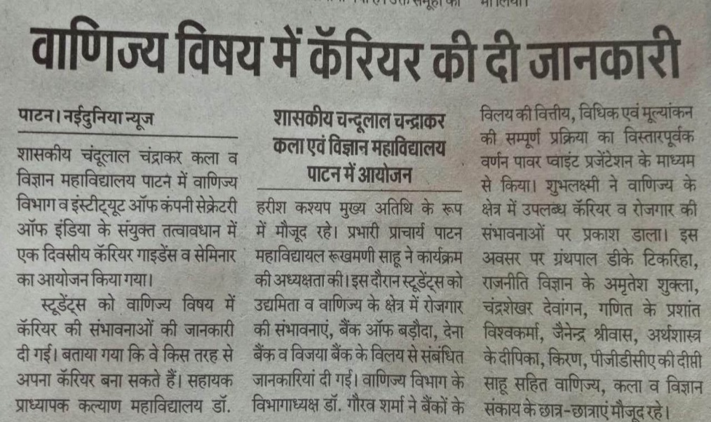
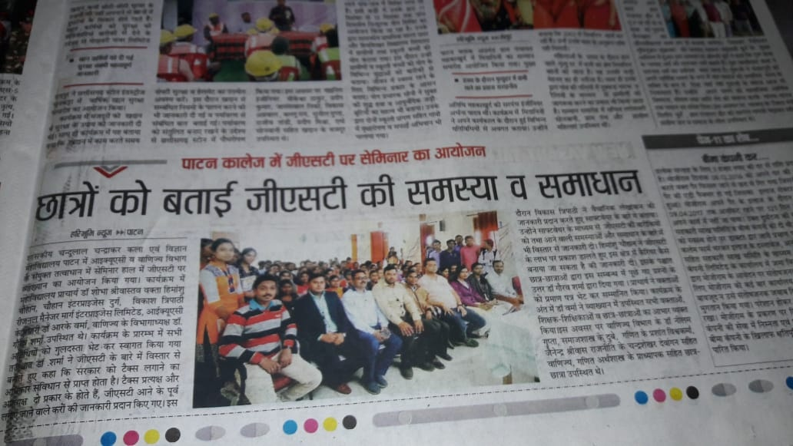
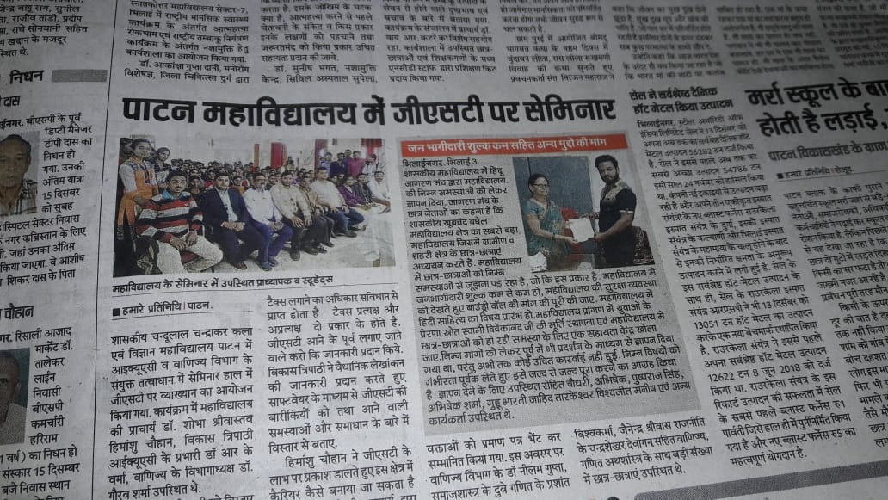
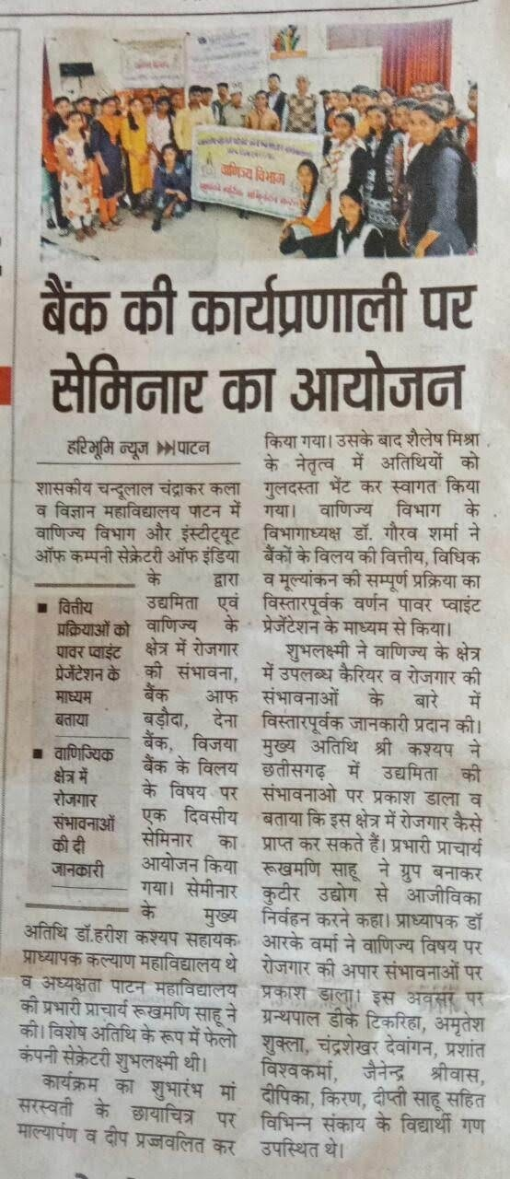
Media Gallery

Slide 29
Thank You
Dr. Gaurav Sharma

